Slide 1
UMBC LIFE SIM 2020 - QUARANTINE EDITION
By: Mark Nay, David Onwonga, Sriram Batchu, Richard Ho
Team BOHN

Slide 2
What is Our Game?
We created this game for students who are enrolled in online classes and cannot relate to on-campus life.
We are trying to teach students better time management skills and about the idea of opportunity cost
This game will be using a mix of virtual and on-campus experiences, such as living on campus while taking virtual classes

Slide 3
How the Game Works
The game is mainly text-based with images used as scenery.
The player will be asked a series of questions about how to spend their time as a student at UMBC
These questions may include:
How many credits are you taking?
How many hours will you work this week?
How much time will you spend on self-care?
The game will a scoring system that combines your wealth, happiness, grades, and stress levels to achieve an overall game score.

Slide 4
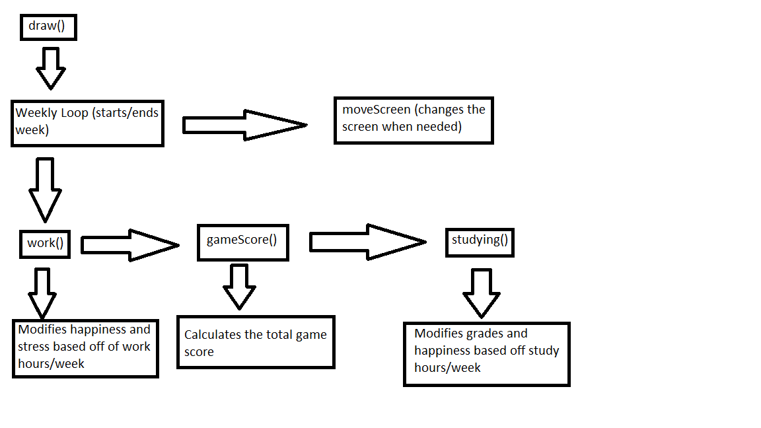
Diagram of Functions

Slide 5
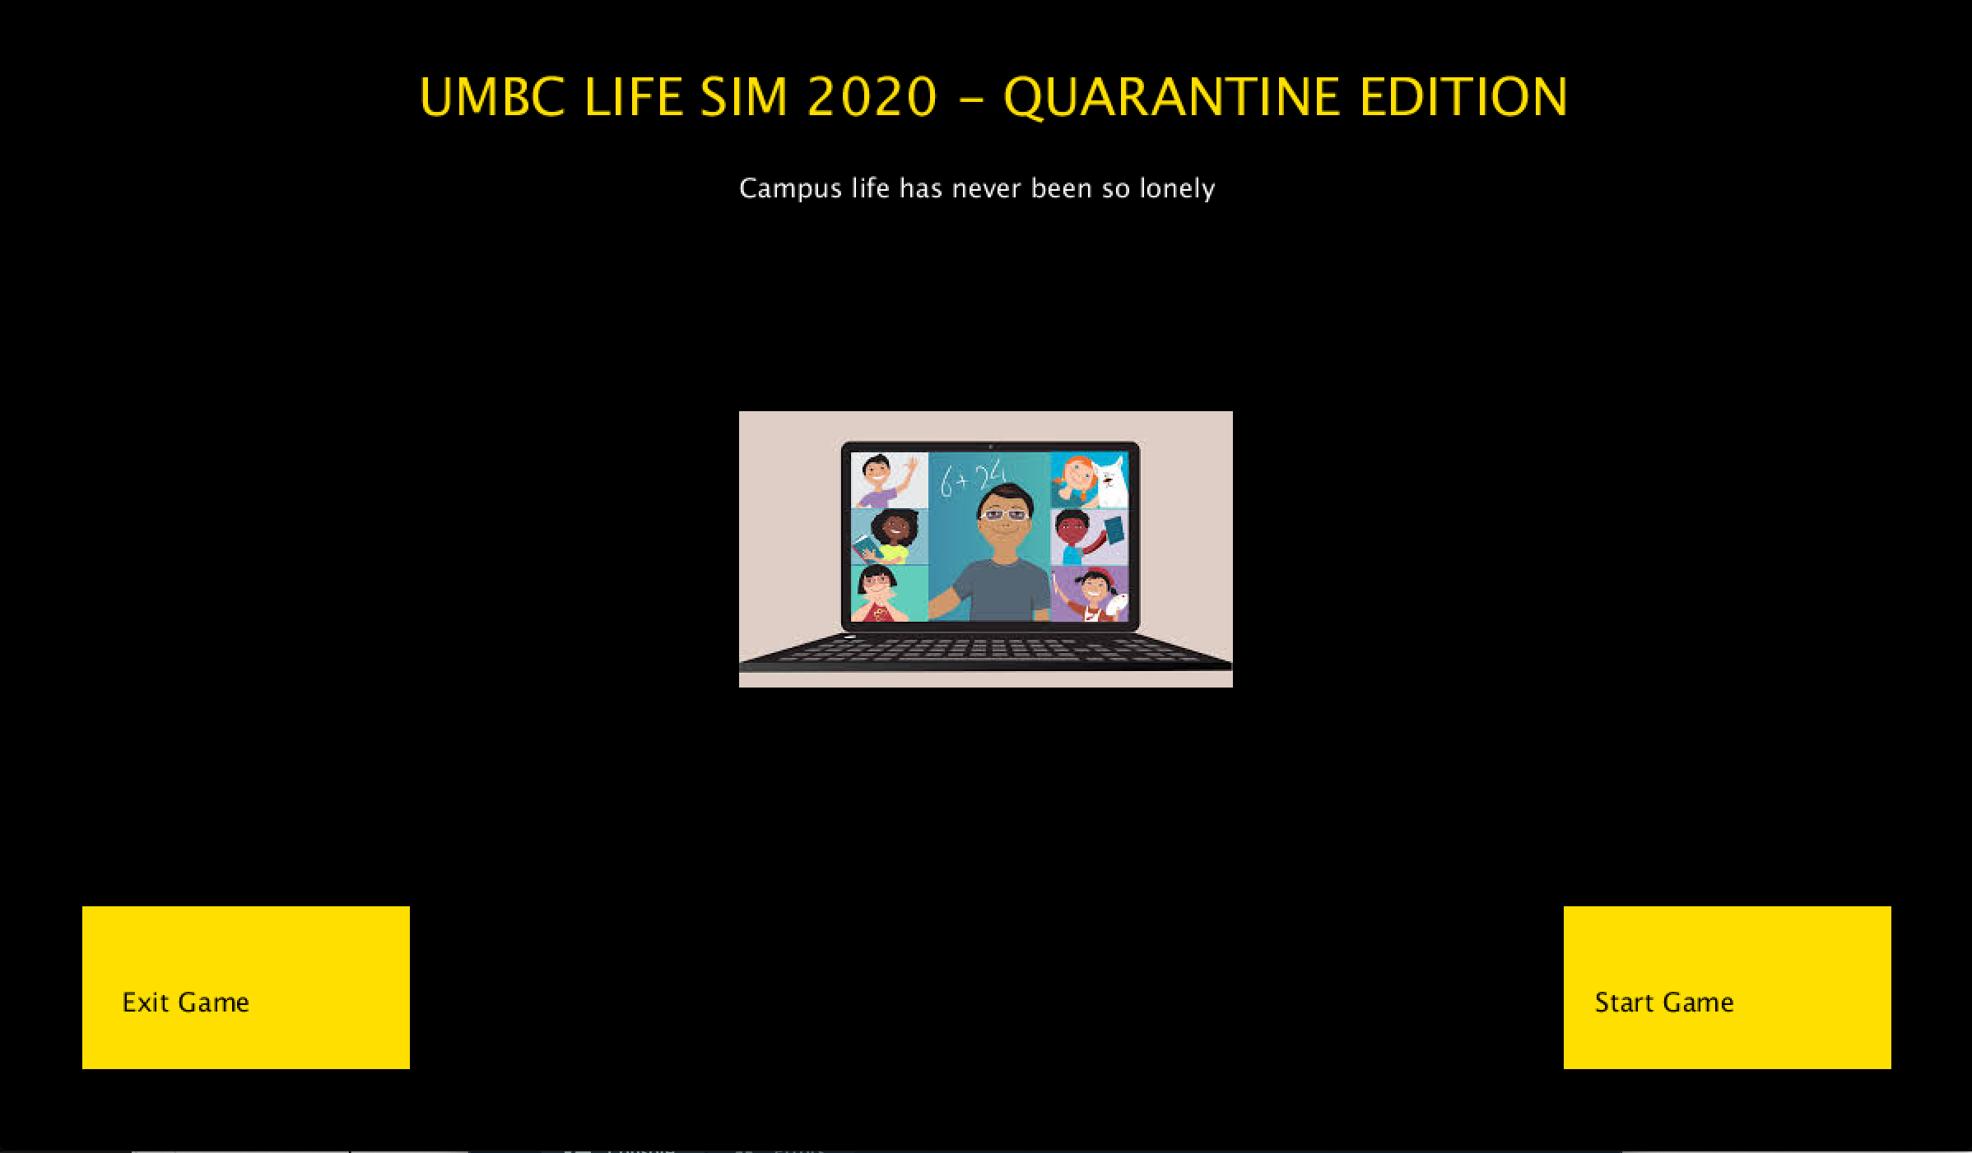
Live Demo of the Game

Slide 6
Sources for images
https://www.google.com/url?sa=i&url=https%3A%2F%2Fwww.additudemag.com%2Fdistance-learning-adhd-advice-for-teachers%2F&psig=AOvVaw0i2Q9115BhufB_Ca7Z773Y&ust=1605570019408000&source=images&cd=vfe&ved=0CA0QjhxqFwoTCJCIysfche0CFQAAAAAdAAAAABAD
https://www.google.com/url?sa=i&url=http%3A%2F%2Fclipart-library.com%2Fschool-counselor-clipart.html&psig=AOvVaw0J-EvBzT78hm6aAOg2W0lx&ust=1605570212857000&source=images&cd=vfe&ved=0CA0QjhxqFwoTCPDWqZ7ghe0CFQAAAAAdAAAAABAK

Slide 7
Sources for images continued
https://www.google.com/url?sa=i&url=http%3A%2F%2Fclipart-library.com%2Fwork-cliparts.html&psig=AOvVaw1YwpADpZcIrP-NYFDW2cL5&ust=1605720765593000&source=images&cd=vfe&ved=0CA0QjhxqFwoTCICZwpCOiu0CFQAAAAAdAAAAABAD
http://clipart-library.com/clipart/1009034.htm

